Slide 1
John 20 19-23
¹⁹ On the evening of that first day of the week, when the disciples were together, with the doors locked for fear of the Jewish leaders, Jesus came and stood among them and said, “Peace be with you!” ²⁰ After he said this, he showed them his hands and side. The disciples were overjoyed when they saw the Lord.
²¹ Again Jesus said, “Peace be with you! As the Father has sent me, I am sending you.” ²² And with that he breathed on them and said, “Receive the Holy Spirit. ²³ If you forgive anyone’s sins, their sins are forgiven; if you do not forgive them, they are not forgiven.”

Slide 2
That is to say, ‘as you proclaim my gospel, I will back up your message; when you preach of pardoning blood, it shall be so; and when you tell those who believe not that they are condemned already, and that except they repent they shall abide in condemnation, their sins shall be retained.
The true minister of God speaketh not apart from the Word of God, and when he speaks the Word of God, the God of the Word is himself there to make it effectual. It shall be no brutum fulmen, no wasted thunderbolt.
Charles H Spurgeon

Slide 3
Greek – Eirene
Hebrew/Aramaic - Shalom
This Photo by Unknown Author is licensed under CC BY-ND

Slide 4
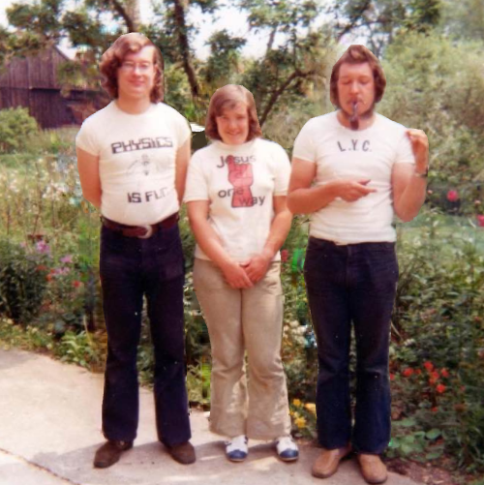
Seventies Siblings!

Slide 5
Nine O’Clock In The Morning
The marks of the Spirit’s presence have always been the same:
A new reality of God
A love for Jesus Christ
A hunger for the scriptures
Spontaneous joy and praise and witness and
Generous giving

Slide 6
Receive peace
Receive the Holy Spirit
This Photo by Unknown Author is licensed under CC BY-NC-ND

